Slide 1
Airbnb Price Prediction in Austin

Slide 2
What is the problem?
Hosts are expected to set their own prices for their listings
Airbnb provides some general guidance. We are trying to improve our base price services.
Our Model helps hosts price their properties accurately using a wide range of data points. Hosts do not lose potential profit and guests get fair deals.

Slide 3
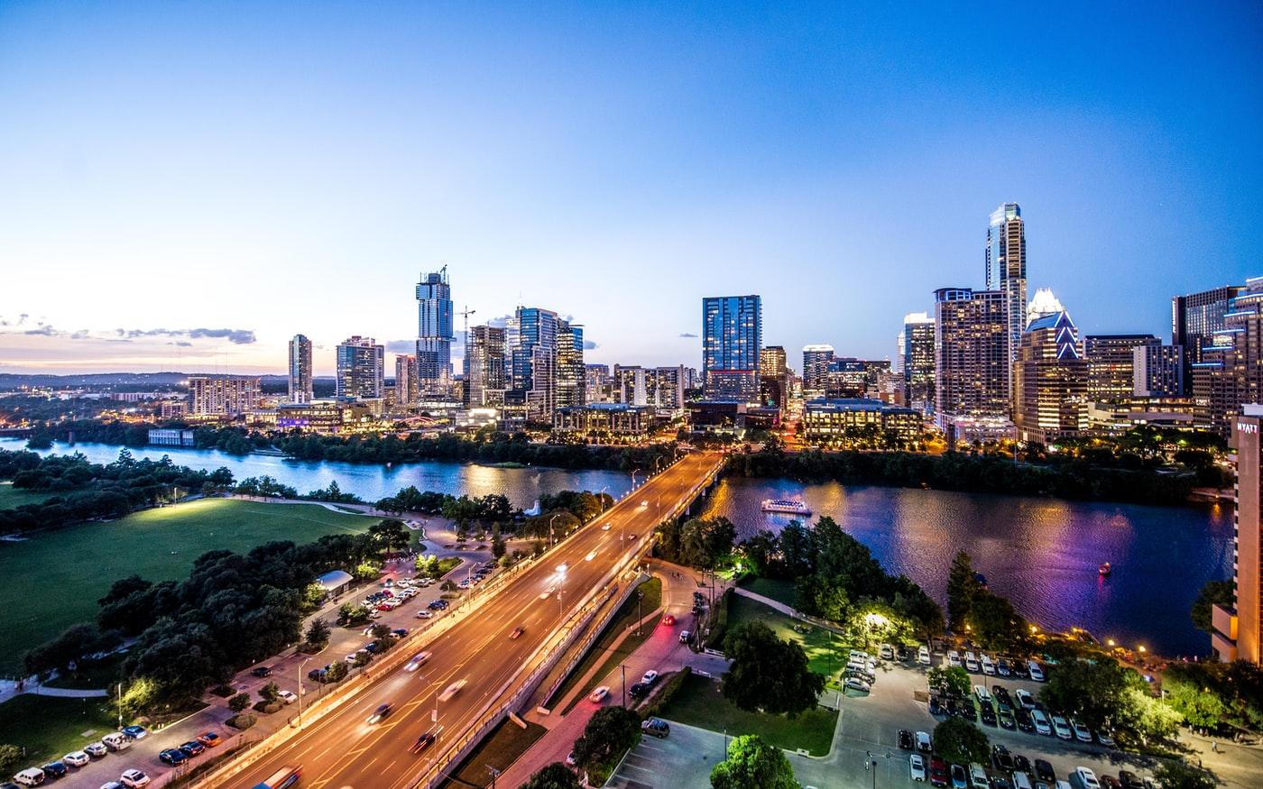
Why do we care about this problem?
Austin hosts a large number of events:
ACL Festival
SXSW
Price too high and no one will book.
Price too low and you’ll be missing out on a lot of potential income.

Slide 4
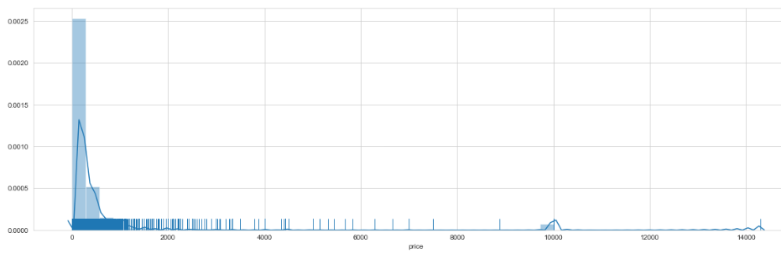
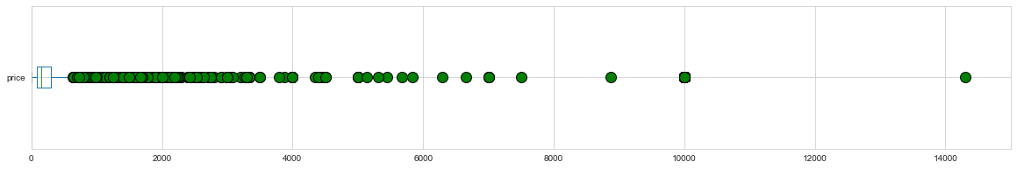
Price Visualization
Price column skewed to the right
Outliers in the Price column

Slide 5
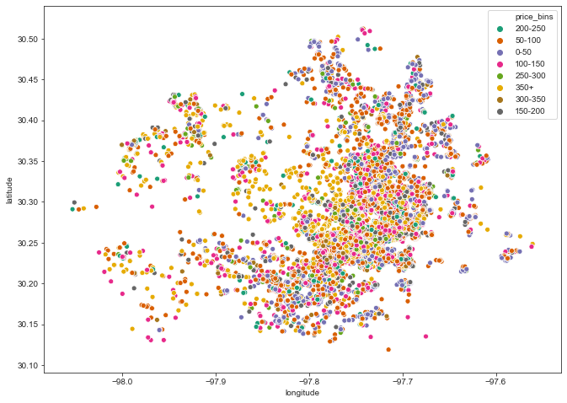
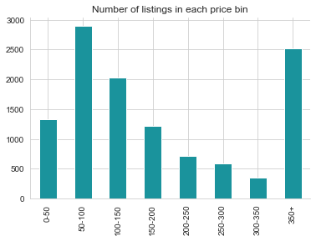
Most of the properties above $350 price range are located on the West side of Austin.

Slide 6
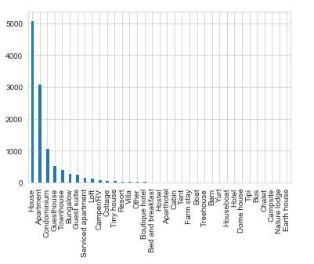
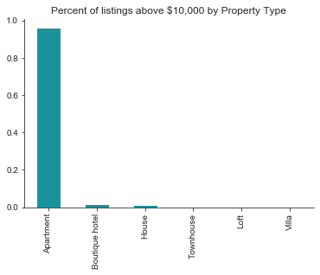
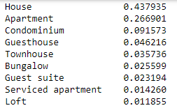
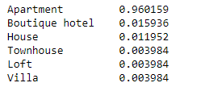
Property Types
Property Types > $10,000

Slide 7
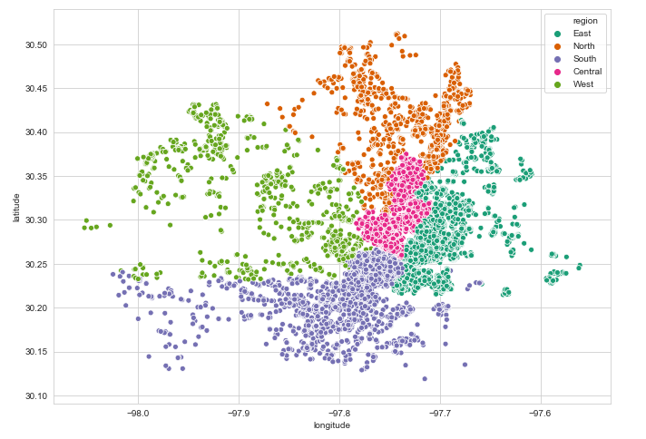
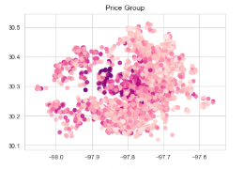
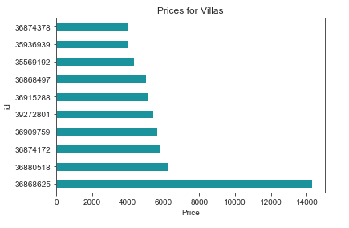
The Most Expensive Property Types

Slide 8
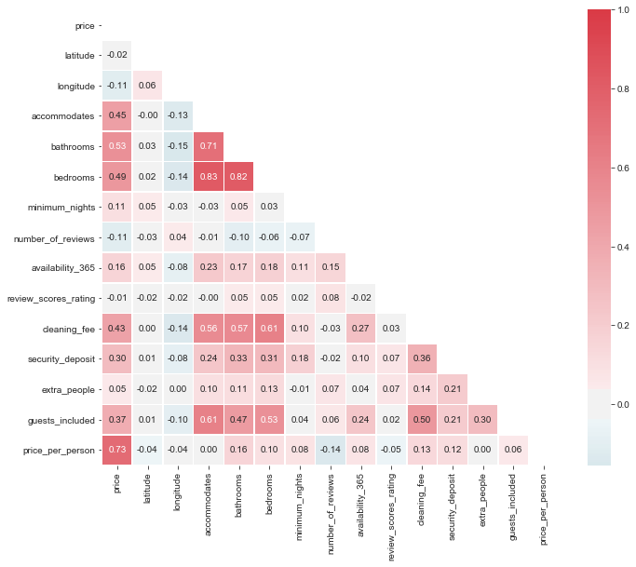
The Correlation Matrix

